Slide 1
Unit 4
Security for E-Government

Slide 2
Introduction
In fact, the security is one of the most significant challenges for implementing e-government initiatives.
Many studies have found that security is one of the most important obstacles.
Security means protection of all information and systems against any disclosure to unauthorized access, or unauthorized modifications or devastation
Thus, it refers to protection of the information systems, assets and the control of access to the information itself.
It is a vital component in the trust relationship between citizens and government.
Security issues may present the largest obstacle to the development of e-government services.
Thus, security policies and standards that meet citizen expectations are an important step toward addressing these concerns .

Slide 3
Introduction
The use of security solutions, including digital signatures, encryption, user names, passwords, customer unique numbers, bank account numbers, and others being transmitted over the Internet and stored electronically can help in fulfilling security goals in e-government applications.
  Furthermore, point out that information security, referred to as cyber security or computer security, is an important e-government challenge.
In addition, security involves continuous vigilance and protection against the increasing danger of worms and viruses.
Also, people need to be educated on the importance of security measures, such as private passwords, to ensure their own protection.
Cyber security has to deal with cyber regulations on different fields such as e-Commerce, e-Banking, e-Government and e-Healthcare, and all these depend on the governance of cyberspace to facilitate the use of web as a medium to promote global interchange without risk.

Slide 4
Security of E-governance
Implementation of E-governance has changed the way of living of the people in various countries.
At present scenario we can say our most activities or needs are totally depend upon the E-governance, that’s why security of E-governance is a major issue.
Here we try to explain an approach for E-governance security which is based on specially two terms i.e. “Security of What?” and other is “Security against What?” in this section we try to work on these two questions
Security of What?
  This is a major question when we talk about E-governance security.
Security is all about protecting the Information and Communication Technology (ICT) assets of an organization

Slide 5
Security of E-governance
Security against What?
There are various threats to security of our ICT system, and we can’t define or declare them exactly, it may come from various sources and in various forms.
  So it is very necessary for e-governance administrator to identify these threats.
In this section we firstly give some sources of threats and then some types of threats which affect to E-governance.
Sources of Threat
The sources of threat can be internal or it can be external to the government body.
There are various internal sources of threat like the employees who work on the E-governance project, customers of the E-governance projects they may attempt to access the databases for their personal financial profit.
When we talk about external sources it may be Professional hackers, Criminal organizations, various Intelligence agencies or Investigation agencies

Slide 6
Security of E-governance
Types of Threat
Threats may include unauthorized access, modification, and destruction of data.
The threats may be of different types varying from time to time because technology changes frequently.
The attacks on security of e-governance system can be in different forms including Defacing of web sites, Hacking, Cracking, Damage to critical database and applications, Network security check list, Viruses and Malwares etc. the damage of ICT assets need not always be a result of such malicious attacks as mentioned previously.
It may be some kind of natural or environmental disasters etc.

Slide 7
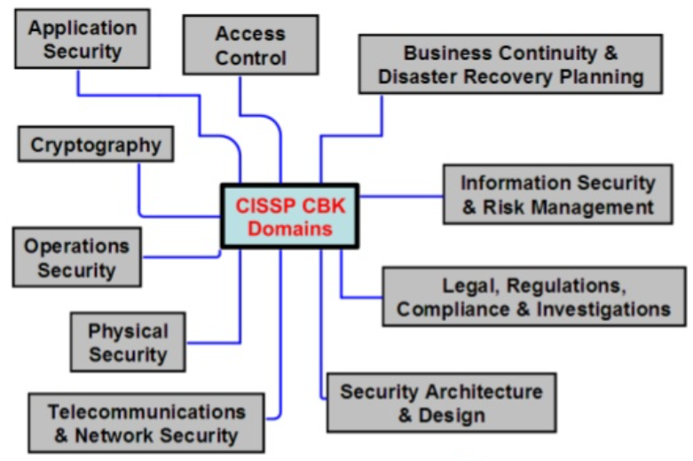
Domains of Security
CISSP CBK: Certificate Information System Security Professional Common Body of Knowledge

Slide 8
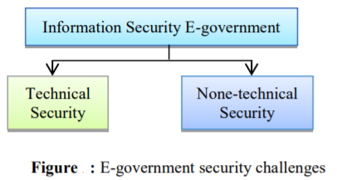
E-government security challenges
The security framework of e-government consists on the main three elements; people, processes and technologies.
Our focus would be on the E-government information security in terms of the technological and non-technological perspectives.
Since, E-government cannot be only the protection of the ICT assets in government bodies.
However, it can be defined as a protection of both technical and non-technical assets of the government departments.
Therefore, security of e-government can be in a broad area as illustrated in figure

Slide 9
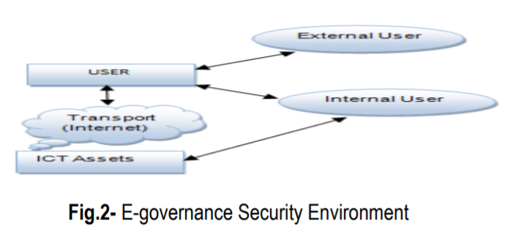
Security Management
The above facts lead us to conclusion that the security of the e-governance system has to be managed systematically in three levels, this model is explained with the help of this figure

Slide 10
Security Management
Security at User Level
Security at user level is a very important issue.
We can classify user level security management in three Parts.
Identity Management
  The main purpose of this is to create unique digital identity or credential to all legal users by providing a unique user name and password, to create and manage ICT systems which ensure that the digital identities are secure.
Access Management System
  In this level the unique credentials which are provided to the user at identity level are matched to identify the user, that he/she is actually the authentic person.

Slide 11
Security Management
Interaction Management System
  Interaction management is a most comprehensive and complex phase.
  It includes assurance of the Integrity, Confidentiality and Non-repudiation principles of a comprehensive security.
In user level, we can use various tools such as digital identity token, public key infrastructure (PKI), digital signature, asymmetric key cryptography etc. to provide or enhance the security at the user level.

Slide 12
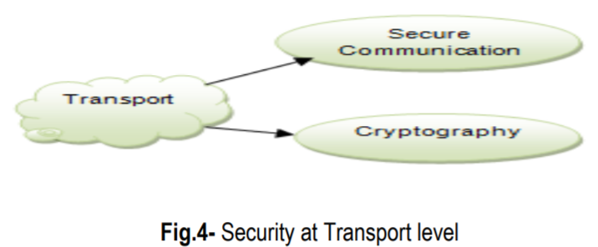
Security Management
Security at Transport Level
  In this level we consider about e-governance security in two aspects which are security within LAN and WAN, and the second one is Security over the Internet.
This security level is classified into two systems, i.e. Secure Communication System and Cryptographic System.

Slide 13
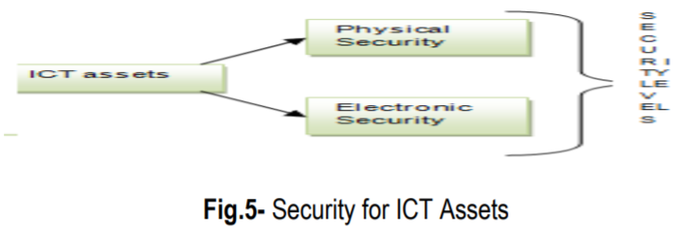
Security Management
Security at ICT Assets level
  ICT assets are the most precious for any organization or institution, so to secure this level we have two broad categories of security treatment i.e. Physical security and Electronic security
Physical Security
  It is used to protect the data against physical damages or losses like- natural disasters etc.
  To protect data in this security level we take some steps such as security level of data centers are highly secured by using biometric-controlled system, in data centers provision of dust-proof environment, fire protection systems, security alarms, CCTV monitoring of data center, automated backup system

Slide 14
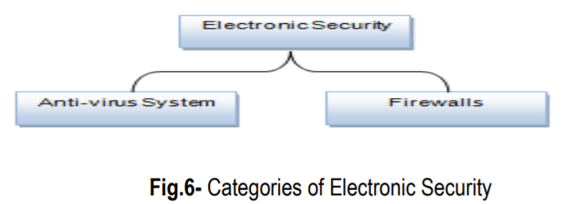
Security Management
Electronic Security
  To give the protection against digital threats we use electronic security.
We have various electronic security tools, and we can manage them in two categories
Anti-virus System
When we discuss about digital threats the first thing in our mind is virus, which affects our ICT assets in various ways such as slowing down of the system, occupy disk space, corrupt valuable data or storage medium etc.
It is also known as malware, worms and Trojan horses.
There are “over 1,122,311 known viruses active in the world as of 2008

Slide 15
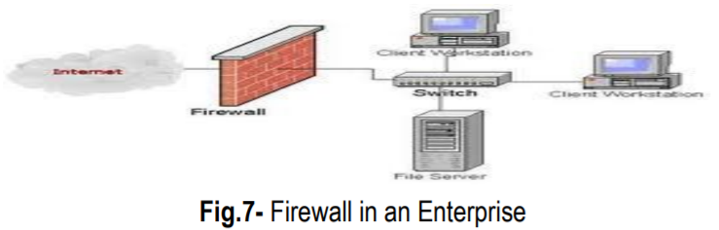
Security Management
Firewalls “A system designed to prevent unauthorized access to or from a private network”.
A firewall is a security device that can be hardware or software that is mainly use for to separate a secure area from a less secure area and to control communications between the two.
We have several firewall techniques such as Packet filter, Application gateway, Circuit-level gateway, Proxy server.
There are many different brands of software firewalls, some of them areZoneAlarm, BlackICE and Kerio etc.

Slide 16
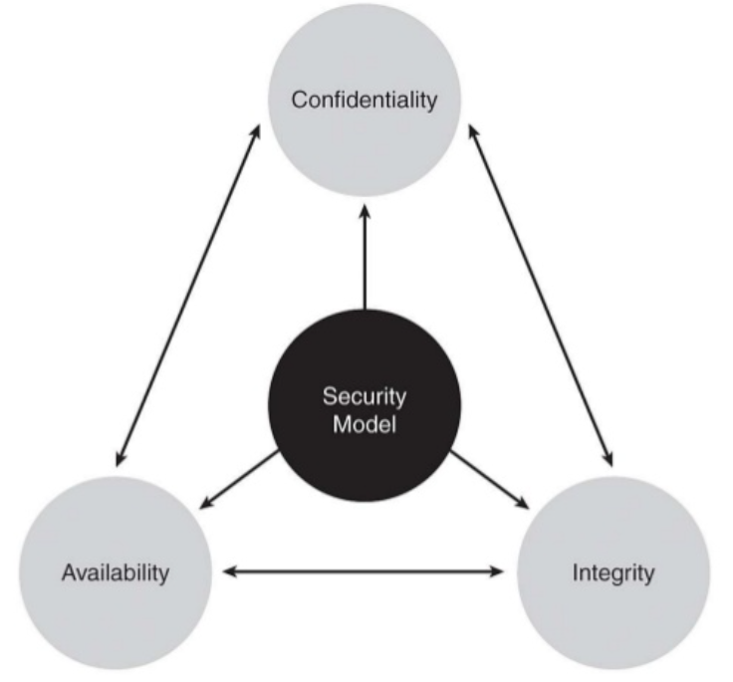
Security Model
Confidentiality/Privacy/Accessibility: ensuring that systems and information are accessible to those authorized to access it.
Integrity: ensuring systems and data have not been tampered with (either accidentally or maliciously) and are in their original and intended state.
Availability: Ensuring that information and vital
IT services are available when required

Slide 17
E-government Security Model
In Implementing the online services, government entities should define the types of security to make the citizens comfortable in using these services.
Citizens and companies must have confidence that both the content and the infrastructure of the internet are secure.
These types of security should emphasis the protection of data privacy, access control, authentication, and network security
The security issues and mechanisms should be included in each task of the e-government model.
These issues and mechanisms constitute the components of a workflow model that has been described by a number of tasks as follows :
Task T1 : A political decision is required to implement IT security.
Task T2 : A security analysis is required to implement the above decision

Slide 18
E-government Security Model
Task T3 : An inclusion of legal frames necessary for ICT security by the formulation of a legal framework for e-commerce, e- government, electronic document exchanges, and telecommunications regulations
Task T4 : An evaluation of confidence of the user in using the network to enforce the ICT security
Task T5 : A definition of security objectives and strategies for e- government, that is made possible once the pilot IT security projects are started
Task T6 : In the construction of an advanced technology secure network, the government needs to define security policies in the transmission network
Task T7 : A promoting of Security Good Habits : the government needs to make plans and incentive actions
Task T8 : The use of technical solutions to set up a local public key infrastructure (PKI)
Task T9 : Enhancing security for online services, the government shall encourage companies
Task T10 : Establishment of IT security Observatory by providing means to collect and analyze information about vulnerabilities and threats

Slide 19
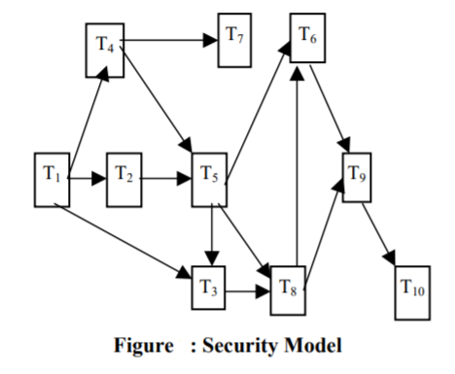
E-government Security Model

Slide 20
E-government Security techniques
To construct an advanced secure network, the government should install solutions to ensure security and confidentiality.
Security policies should be defined to allow several security levels according to the type of assets.
It is suggested to consider this problem as three hierarchical levels: the national level, the intranet level and the server level.
For each level, the threats, the risk of the threats, and their corresponding security solutions are identified.
A Virtual Private Network (VPN) seems to be a good solution to provide privacy and confidentiality.
Governments has to promote the use of such a solution to secure the e-services.

Slide 21
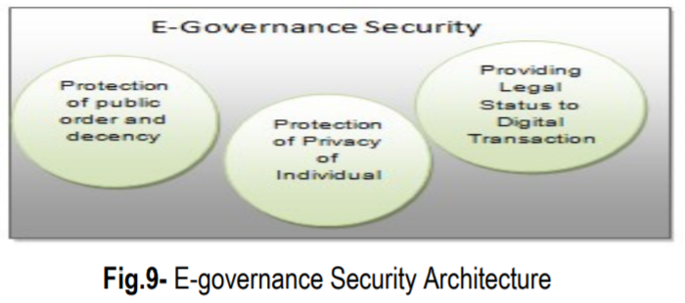
Security Architecture
The security architecture of E-governance is a high level document that set the security goals of e-governance project and describe the procedure that need to be followed by all the e-governance hierarchy such as users, businesses, operators etc.
Appropriate legal framework is absolutely essential for the systematic and sustained growth of e-governance

Slide 22
Protection of Public Order and Decency
The internet is a highly capable of being saturated and versatile medium at the same time.
  Its reach is very vast and due to its multimedia capability its impact can be immediate and profound.
So the government has to beware of its potential to create a negative impact on society through promotion of terrorism, pornography, communalism, violence etc.
Section 67 of the IT Act 2000 of India makes it a punishable offence to “publish or transmit or cause to be published in the electronic form, an material which is lascivious or appeals to the prurient interest or if its effect is such as to tend to deprave and corrupt persons who are likely, having regard to all relevant circumstances, to read, see or hear the matter contained or embodied in it”.
The enormity of the Internet pornography and immense responsibility of governments in intervention can be gauged from the following statistics on the subject, taken from Internet Filter Review 2004, on 24 October 2003:
  Number of pornographic web sites on the internet: 370 million.
  Number of child pornographic web sites on the Internet: 100,000.
  Size of pornographic industry world-wide: US$ 57 billion.
  Size of Internet pornographic industry: US$ 2.5 billion.

Slide 23
Protection of Privacy of Individuals
Disclosure of personal information over the internet raises questions related to the privacy of individuals.
The United States passes an Act which is “The Privacy Act of 1974”.
According to this Act any organization should followed some steps when it gathered any personal information of any individual- Notice, Choice, Onward Transfer and Security

Slide 24
Providing Legal Status to Digital Identities and Transactions
One of the fundamental requirements of e-governance projects is its ability to create and sustain the operations of government agencies as well as private agencies.
So it’s very necessary to consult legal status of entities and actions such as ‘legal status is to be provided to the digital identities’, ‘provide the legal recognition to digital assets’, ‘ provide a digital authority to digital transactions, these transactions could be in the areas of G2G, G2B,G2C etc’. ‘Agreements and contracts in digital form’.
To providing the authority to any legal digital transaction or deal the Indian government gave ‘Information Technology Act 2000’ in October 2000.
It specifically takes care of all the issues mentioned above.
India followed some provisions of ‘Electronic transaction Act 1998 (Singapore)’ closely while drafting the IT Act 2000.

Slide 25
Security Standards
The standard for information security was set by the BS 7799, being its popularity it was adopted by ISO as ISO 17799 and its sequel BS 7799-2 that prescribes the specification for Information Security Management.
“The ISO 27001 standard was published in October 2005, essentially replacing the old BS 7799-2 standard.
  It is the specification for an Information Security Management System”.
“ISO 17799 defines 127 security controls structured under 10 major headings to enable the information security manager to identify the particular safeguards that are appropriate to there specific area of responsibility

